Slide 1

Data Management Using Microsoft SQL Server
SQL
Server
2012
Session: 1
Introduction to the Web
Session: 7
Creating Tables

Slide 2



SQL
Server
2012
SQL
Server
2012
List SQL Server 2012 data types
Describe the procedure to create, modify, and drop tables in
an SQL Server database
Describe the procedure to add, modify, and drop columns in a table

Slide 3

SQL
Server
2012
SQL
Server
2012
One of the most important types of database objects in SQL Server 2012 is a table.
Tables in SQL Server 2012 contain data in the form of rows and columns.
Each column may have data of a specific type and size.

Slide 4



SQL
Server
2012
SQL
Server
2012
A data type is an attribute that specifies the type of data an object can hold, such as
numeric data, character data, monetary data, and so on.
Once a column has been defined to store data belonging to a particular data type, data of another type cannot be stored in it.
Hence, if an attempt is made to enter character data into an integer column, it will
not succeed.

Slide 5
SQL
Server
2012
SQL Server 2012 supports three kinds of data types:
System data types
These are provided by SQL Server 2012.
Alias data types
These are based on the system-supplied data types.
One of the typical uses of alias data types is when more than one table stores the same type of data in a column and has similar characteristics such as length, nullability, and type.
In such cases, an alias data type can be created that can be used
commonly by all these tables.
User-defined types
These are created using programming languages supported by the
.NET Framework, which is a software framework developed by Microsoft.
SQL
Server
2012

Slide 6
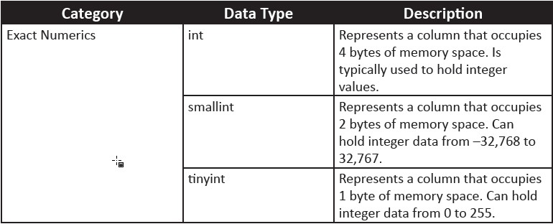
SQL
Server
2012
SQL
Server
2012
Following table shows various data types in SQL Server 2012 along with their categories and description:

Slide 7
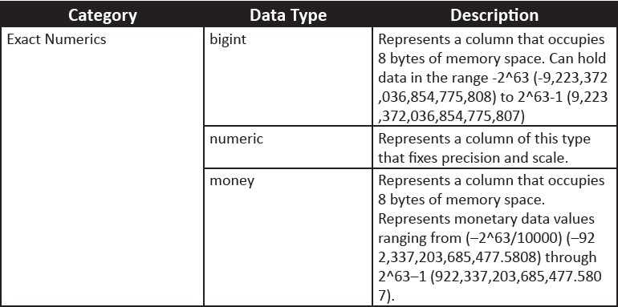
SQL
Server
2012
SQL
Server
2012

Slide 8
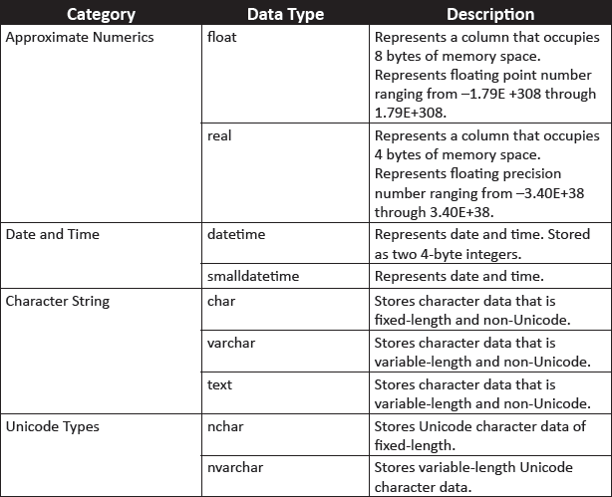
SQL
Server
2012
SQL
Server
2012

Slide 9
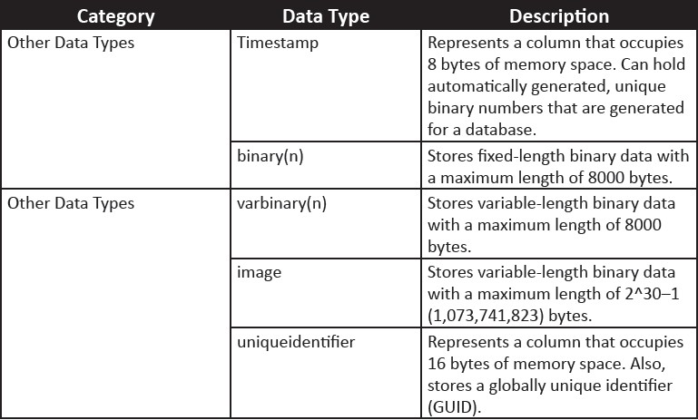
SQL
Server
2012
SQL
Server
2012

Slide 10

SQL
Server
2012
SQL
Server
2012
Alias data types can be created using the CREATE TYPE statement.
The syntax for the CREATE TYPE statement is as follows:
Syntax:
CREATE TYPE[ schema_name.] type_name{FROM base_type[(
precision[,scale])][NULL|NOT NULL]}[;]
where,
schema_name: identifies the name of the schema in which the alias data type is
being created.
type_name: identifies the name of the alias type being created.
base_type: identifies the name of the system-defined data type based on which the alias data type is being created.
precision and scale: specify the precision and scale for numeric data.
NULL|NOT NULL: specifies whether the data type can hold a null value or not.
Following code snippet shows how to create an alias data type named
usertype using the CREATE TYPE statement:
CREATE TYPE usertype FROM varchar(20) NOT NULL

Slide 11

SQL
Server
2012
SQL
Server
2012
The CREATE TABLE statement is used to create tables in SQL Server 2012.
The syntax for CREATE TABLE statement is as follows:
Syntax:
CREATE TABLE [database_name. [schema_name].| schema_name.]table_name
([<column_name>] [data_type] Null/Not Null,)
ON [filegroup | “default”] GO
where,
database_name: is the name of the database in which the table is created.
table_name: is the name of the new table. table_name can be a maximum of
128 characters.
column_name: is the name of a column in the table. column_name can be up to
128 characters. column_name are not specified for columns that are created with a timestamp data type. The default column name of a timestamp column is timestamp. data_type: It specifies data type of the column.

Slide 12

SQL
Server
2012
SQL
Server
2012
Following code snippet demonstrates creation of a table named
dbo.Customer_1:
CREATE TABLE [dbo].[Customer_1](
[Customer_id number] [numeric](10, 0) NOT NULL, [Customer_name] [varchar](50) NOT NULL)
ON [PRIMARY] GO

Slide 13

SQL
Server
2012
The ALTER TABLE statement is used to modify a table definition by altering, adding, or dropping columns and constraints, reassigning partitions, or disabling or enabling constraints and triggers.
The syntax for ALTER TABLE statement is as follows:
Syntax:
SQL
Server
2012
ALTER TABLE [[database_name. [schema_name].| schema_name.]table_name
ALTER COLUMN ([<column_name>] [data_type] Null/Not Null,);
| ADD ([<column_name>] [data_type] Null/Not Null,);
| DROP COLUMN ([<column_name>];
where,
ALTER COLUMN: specifies that the particular column is to be changed or modified.
ADD: specifies that one or more column definitions are to be added.
DROP COLUMN ([<column_name>]: specifies that column_name is to be removed from the table.

Slide 14

SQL
Server
2012
Following code snippet demonstrates altering the Customer_id column:
SQL
Server
2012
USE [CUST_DB]
ALTER TABLE [dbo].[Customer_1]
ALTER Column [Customer_id number] [numeric](12, 0) NOT NULL;
Following code snippet demonstrates adding the Contact_number column:
USE [CUST_DB]
ALTER TABLE [dbo].[Table_1]
ADD [Contact_number] [numeric](12, 0) NOT NULL;
Following code snippet demonstrates dropping the Contact_number
column:
USE [CUST_DB]
ALTER TABLE [dbo].[Table_1] DROP COLUMN [Contact_name];
Under certain conditions, columns cannot be dropped, such as, if they are used in a CHECK, FOREIGN KEY, UNIQUE, or PRIMARY KEY constraint, associated with a DEFAULT definition, and so forth.

Slide 15

SQL
Server
2012
The DROP TABLE statement removes a table definition, its data, and all associated objects such as indexes, triggers, constraints, and permission specifications for that table.
The syntax for DROP TABLE statement is as follows:
Syntax:
SQL
Server
2012
DROP TABLE <Table_Name>
where,
<Table_Name>: is the name of the table to be dropped.
Following code snippet demonstrates how to drop a table:
USE [CUST_DB]
DROP TABLE [dbo].[Table_1]

Slide 16

SQL
Server
2012
SQL
Server
2012
The statements used for modifying data are INSERT, UPDATE, and DELETE
statements.
These are explained as follows:
INSERT Statement
The INSERT statement adds a new row to a table.
The syntax for INSERT statement is as follows:
Syntax:
INSERT [INTO] <Table_Name> VALUES <values>
where,
<Table_Name>: is the name of the table in which row is to be inserted.
[INTO]: is an optional keyword used between INSERT and the target table.
<Values>: specifies the values for columns of the table.

Slide 17
SQL
Server
2012
Following code snippet demonstrates adding a new row to the Table_2 table:
SQL
Server
2012
USE [CUST_DB]
INSERT INTO [dbo].[Table_2] VALUES (101, 'Richard Parker', 'Richy')
GO
The outcome of this will be that one row with the given data is inserted into the table.
UPDATE Statement
The UPDATE statement modifies the data in the table.
The syntax for UPDATE statement is as follows:
Syntax:
UPDATE <Table_Name>
SET <Column_Name = Value> [WHERE <Search condition>]
where,
<Table_Name>: is the name of the table where records are to be updated.
<Column_Name>: is the name of the column in the table in which record is to be updated.

Slide 18

SQL
Server
2012
SQL
Server
2012
<Value>: specifies the new value for the modified column.
<Search condition>: specifies the condition to be met for the rows to be
deleted.
Following code snippet demonstrates the use of the UPDATE statement to modify the value in column Contact_number:
USE [CUST_DB]
UPDATE [dbo].[Table_2] SET Contact_number = 5432679 WHERE Contact_name
LIKE 'Richy'
GO
Following figure shows the output of UPDATE statement:

Slide 19
SQL
Server
2012
SQL
Server
2012
DELETE Statement
The DELETE statement removes rows from a table.
The syntax for DELETE statement is as follows:
Syntax:
DELETE FROM <Table_Name>
[WHERE <Search condition>]
where,
<Table_Name>: is the name of the table from which the records are to be
deleted.
The WHERE clause is used to specify the condition. If WHERE clause is not included in the DELETE statement, all the records in the table will be deleted.
Following code snippet demonstrates how to delete a row from the Customer_2
table whose Contact_number value is 5432679:
USE [CUST_DB]
DELETE FROM [dbo].[Customer_2] WHERE Contact_number = 5432679 GO

Slide 20




SQL
Server
2012
SQL
Server
2012
The nullability feature of a column determines whether rows in the table can
contain a null value for that column.
Product table of the AdventureWorks2012 database does not mean that the product has no color; it just means that the color for the product is unknown or has not been set.
The NULL keyword is used to indicate that null values are allowed in the column,
and the NOT NULL keywords are used to indicate that null values are not allowed.

Slide 21

SQL
Server
2012
SQL
Server
2012
When inserting a row, if no value is given for a nullable column, then, SQL Server automatically gives it a null value unless the column has been given a default definition.
Making a column non-nullable enforces data integrity by ensuring that the column contains data in every row.
In the following code snippet, the CREATE TABLE statement uses the NULL and
NOT NULL keywords with column definitions:
USE [CUST_DB]
CREATE TABLE StoreDetails ( StoreID int NOT NULL, Name varchar(40) NULL)
GO
The result of the code is that the StoreDetails table is created with StoreID
and Name columns added to the table.

Slide 22
SQL
Server
2012
SQL
Server
2012
A DEFAULT definition can be given for the column to assign it as a default value if
no value is given at the time of creation.
A DEFAULT definition for a column can be created at the time of table creation or added at a later stage to an existing table.

Slide 23
SQL
Server
2012
SQL
Server
2012
In the following code snippet, the CREATE TABLE statement uses the DEFAULT
keyword to define the default value for Price:
USE [CUST_DB]
CREATE TABLE StoreProduct( ProductID int NOT NULL, Name varchar(40) NOT NULL, Price money NOT NULL DEFAULT (100))
GO
When a row is inserted using a statement as shown in the following code snippet, the value of Price will not be blank; it will have a value of 100.00 even though a user has not entered any value for that column.
USE [CUST_DB]
INSERT INTO dbo.StoreProduct (ProductID, Name) VALUES (111, 'Rivets') GO

Slide 24
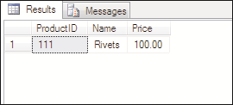
SQL
Server
2012
SQL
Server
2012
Following figure shows the output, where though values are added only to the ProductID and Name columns, the Price column will still show a value of 100.00.
This is because of the DEFAULT definition.
The following cannot be created on columns with DEFAULT definitions:
A timestamp data type
An IDENTITY or ROWGUIDCOL property
An existing default definition or default object

Slide 25
SQL
Server
2012
SQL
Server
2012
The IDENTITY property of SQL Server is used to create identifier columns that can contain auto-generated sequential values to uniquely identify each row within a table.
An identity column is often used for primary key values. The characteristics of the
IDENTITY property are as follows:
 | A column having IDENTITY property must be defined using one of the following data types: decimal,
 | int, numeric, smallint, bigint, or tinyint.
 | A column having IDENTITY property need not have a seed and increment value specified. If they are not
 | specified, a default value of 1 will be used for both.
A table cannot have more than one column with IDENTITY property.
 | The identifier column in a table must not allow null values and must not contain a DEFAULT definition or
 | object.
Columns defined with IDENTITY property cannot have their values updated.
 | The values can be explicitly inserted into the identity column of a table only if the
 | IDENTITY_INSERT option is set ON.
When IDENTITY_INSERT is ON, INSERT statements must supply a value.

Slide 26
SQL
Server
2012
SQL
Server
2012
Once the IDENTITY property has been set, retrieving the value of the identifier column can be done by using the IDENTITYCOL keyword with the table name in a SELECT statement.
To know if a table has an IDENTITY column, the OBJECTPROPERTY() function can be used.
To retrieve the name of the IDENTITY column in a table, the COLUMNPROPERTY
function is used.
The syntax to add a IDENTITY property while creating a table is as follows:
Syntax:
CREATE TABLE <table_name> (column_name data_type [ IDENTITY
[(seed_value, increment_value)]] NOT NULL )
where,
seed_value: is the seed value from which to start generating identity values.
increment_value: is the increment value by which to increase each time.

Slide 27
SQL
Server
2012
Following code snippet demonstrates the use of IDENTITY property:
SQL
Server
2012
USE [CUST_DB]
GO
CREATE TABLE HRContactPhone ( Person_ID int IDENTITY(500,1) NOT NULL, MobileNumber bigint NOT NULL )
GO
HRContactPhone is created as a table with two columns in the schema Person
that is available in the CUST_DB database.
The Person_ID column is an identity column.
The seed value is 500, and the increment value is 1.
While inserting rows into the table, if IDENTITY_INSERT is not turned on, then,
explicit values for the IDENTITY column cannot be given.

Slide 28

SQL
Server
2012
Instead, statements similar to the following code snippet can be given:
SQL
Server
2012
USE [CUST_DB]
INSERT INTO HRContactPhone (MobileNumber) VALUES(983452201) INSERT INTO HRContactPhone (MobileNumber) VALUES(993026654) GO
Following figure shows the output where IDENTITY property is incrementing
Person_ID column values:

Slide 29
SQL
Server
2012
SQL
Server
2012
 | In addition to the IDENTITY property, SQL Server also supports globally unique
 | identifiers.
 | Only one identifier column and one globally unique identifier column can be created for each
 | table.
 | To create and work with globally unique identifiers, a combination of ROWGUIDCOL,
 | uniqueidentifier data type, and NEWID function are used.
Values for a globally unique column are not automatically generated.
 | One has to create a DEFAULT definition with a NEWID() function for a
 | uniqueidentifier column to generate a globally unique value.

Slide 30
SQL
Server
2012
SQL
Server
2012
The NEWID() function creates a unique identifier number which is a 16-byte binary string.
The column can be referenced in a SELECT list by using the ROWGUIDCOL keyword.
To know whether a table has a ROWGUIDCOL column, the OBJECTPROPERTY function is used.
The COLUMNPROPERTY function is used to retrieve the name of the ROWGUIDCOL column.

Slide 31

SQL
Server
2012
SQL
Server
2012
Following code snippet demonstrates how to CREATE TABLE statement to create the EMPCellularPhone table.
The Person_ID column automatically generates a GUID for each new row added
to the table.
USE [CUST_DB]
CREATE TABLE EMP_CellularPhone( Person_ID uniqueidentifier DEFAULT NEWID() NOT NULL, PersonName varchar(60) NOT NULL)
GO
Following code snippet adds a value to PersonName column:
USE [CUST_DB]
INSERT INTO EMP_CellularPhone(PersonName) VALUES ('William Smith')
SELECT * FROM EMP_CellularPhone
GO
Following figure shows the output where a unique identifier is displayed against a
specific PersonName:

Slide 32

SQL
Server
2012
SQL
Server
2012
A constraint is a property assigned to a column or set of columns in a table to prevent certain types of inconsistent data values from being entered.
Constraints are used to apply business logic rules and enforce data integrity.
Constraints can be created when a table is created or added at a later stage using the ALTER
TABLE statement.
Constraints can be categorized as column constraints and table constraints.
A column constraint is specified as part of a column definition and applies only to that column.
A table constraint can apply to more than one column in a table and is declared independently from a column definition. .
Table constraints must be used when more than one column is included in a constraint.
SQL Server supports the following types of constraints:
PRIMARY KEY
UNIQUE
FOREIGN KEY
CHECK
NOT NULL

Slide 33
SQL
Server
2012
SQL
Server
2012
A table typically has a primary key comprising a single column or combination of columns to uniquely identify each row within the table.
Only one primary key constraint can be created per table.
The syntax to add a primary key while creating a table is as follows:
Syntax:
CREATE TABLE <table_name> ( Column_name datatype PRIMARY KEY [
column_list] )

Slide 34

SQL
Server
2012
SQL
Server
2012
Following code snippet demonstrates how to create a table EMPContactPhone to store the contact telephone details of a person.
Since the column EMP_ID must be a primary key for identifying each row uniquely,
it is created with the primary key constraint.
USE [CUST_DB]
CREATE TABLE EMPContactPhone ( EMP_ID int PRIMARY KEY, MobileNumber bigint, ServiceProvider varchar(30), LandlineNumber bigint)
GO
An alternative approach is to use the CONSTRAINT keyword. The syntax is as follows:
Syntax:
CREATE TABLE <table_name> (<column_name> <datatype> [, column_list] CONSTRAINT constraint_name PRIMARY KEY)

Slide 35
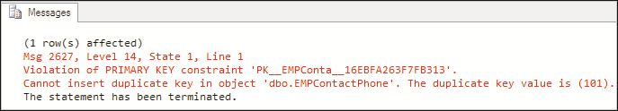

SQL
Server
2012
SQL
Server
2012
Having created a primary key for EMP_ID, a query is written to insert rows into the table with the statements shown in the following code snippet:
USE [CUST_DB]
INSERT INTO dbo.EMPContactPhone values (101, 983345674,'Hutch', NULL) INSERT INTO dbo.EMPContactPhone values (102, 989010002,'Airtel', NULL) GO
The first statement shown in the code snippet is executed successfully but the next INSERT statement will fail because the value for EMP_ID is duplicate as shown in the following figure:
The output is shown in the following figure:

Slide 36

SQL
Server
2012
SQL
Server
2012
A UNIQUE constraint is used to ensure that only unique values are entered in a column or set of columns.
UNIQUE constraints allow null values.
A single table can have more than one UNIQUE constraint.
The syntax to create UNIQUE constraint is as follows:
Syntax:
CREATE TABLE <table_name> ([column_list ] <column_name> <data_type> UNIQUE [ column_list])
Following code snippet demonstrates how to make the MobileNumber and
LandlineNumber columns as unique:
USE [CUST_DB]
GO
CREATE TABLE EMP_ContactPhone(Person_ID int PRIMARY KEY, MobileNumber
bigint UNIQUE,ServiceProvider varchar(30),LandlineNumber bigint UNIQUE)

Slide 37

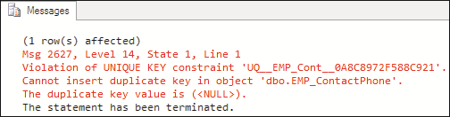

SQL
Server
2012
Following code snippet demonstrates how to insert a row into the table:
SQL
Server
2012
USE [CUST_DB]
INSERT INTO EMP_ContactPhone values (111, 983345674, 'Hutch', NULL)
INSERT INTO EMP_ContactPhone values (112, 983345674, 'Airtel', NULL) GO
UNIQUE constraints check only for the uniqueness of values but do not prevent null entries.
The second INSERT statement will fail because the value for MobileNumber is a
duplicate as shown in the following figure:
This is because the column MobileNumber is defined to be unique and disallows
duplicate values. The output is shown in the following figure:

Slide 38
SQL
Server
2012
SQL
Server
2012
A foreign key in a table is a column that points to a primary key column in another table.
Foreign key constraints are used to enforce referential integrity.
The syntax for foreign key is as follows:
Syntax:
CREATE TABLE <table_name1>([ column_list,] <column_name> <datatype>
FOREIGN KEY REFERENCES <table_name> (pk_column_name> [, column_list])
where,
table_name: is the name of the table from which to reference primary key.
<pk_column_name>: is the name of the primary key column.
Following code snippet demonstrates how to create a foreign key constraint:
USE [CUST_DB]
GO
CREATE TABLE EMP_PhoneExpenses ( Expense_ID int PRIMARY KEY, MobileNumber bigint FOREIGN KEY REFERENCES EMP_ContactPhone (MobileNumber), Amount bigint)

Slide 39
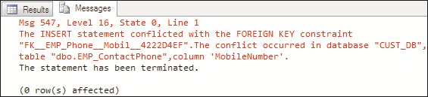
SQL
Server
2012
SQL
Server
2012
A row is inserted into the table such that the mobile number is the same as one of the mobile numbers in EMP_ContactPhone.
The command that will be written is shown in the following code snippet:
INSERT INTO dbo.EMP_PhoneExpenses values(101, 993026654, 500)
SELECT * FROM dbo.EMP_PhoneExpenses
The error message of the code snippet is shown in the following figure:
If there is no key in the referenced table having a value that is being inserted into
the foreign key, the insertion will fail as shown in the figure.
It is, however, possible to add NULL value into a foreign key column.

Slide 40

SQL
Server
2012
SQL
Server
2012
A CHECK constraint limits the values that can be placed in a column.
Check constraints enforce integrity of data.
A CHECK constraint operates by specifying a search condition, which can evaluate to
TRUE, FALSE, or unknown.
Values that evaluate to FALSE are rejected.
Multiple CHECK constraints can be specified for a single column.
A single CHECK constraint can also be applied to multiple columns by creating it at
the table level.
Following code snippet demonstrates creating a CHECK constraint to ensure that the Amount value will always be non-zero:
USE [CUST_DB]
CREATE TABLE EMP_PhoneExpenses ( Expense_ID int PRIMARY KEY, MobileNumber bigint FOREIGN KEY REFERENCES EMP_ContactPhone (MobileNumber), Amount bigint CHECK (Amount >10))
GO
A NULL value can, however, be added into Amount column if the value of Amount
is not known.

Slide 41

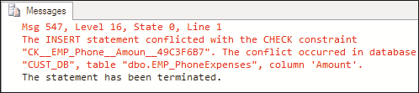
SQL
Server
2012
SQL
Server
2012
Once a CHECK constraint has been defined, if an INSERT statement is written with
data that violates the constraint, it will fail as shown in the following code snippet:
USE [CUST_DB]
INSERT INTO dbo.EMP_PhoneExpenses values (101, 983345674, 9) GO
The error message of the code snippet that appears when the Amount constraint is
less than 10 is shown in the following figure:

Slide 42

SQL
Server
2012
SQL
Server
2012
A NOT NULL constraint enforces that the column will not accept null values.
The NOT NULL constraints are used to enforce domain integrity, similar to
CHECK constraints.

Slide 43

SQL
Server
2012
A data type is an attribute that specifies the storage capacity of an object and the type of data it can hold, such as numeric data, character data, monetary data, and so on.
SQL Server 2012 supports three kinds of data types:
System data types
Alias data types
User-defined types
Most tables have a primary key, made up of one or more columns of the table that identifies records uniquely.
The nullability feature of a column determines whether rows in the table can contain a null value for that column.
SQL
Server
2012

Slide 44

SQL
Server
2012
A DEFAULT definition for a column can be created at the time of table creation or added at a later stage to an existing table.
The IDENTITY property of SQL Server is used to create identifier columns that can contain auto-generated sequential values to uniquely identify each row within a table.
Constraints are used to apply business logic rules and enforce data integrity.
A UNIQUE constraint is used to ensure that only unique values are entered in a column or set of columns.
A foreign key in a table is a column that points to a primary key column in another table.
A CHECK constraint limits the values that can be placed in a column.
SQL
Server
2012

